Slide 1

An Insight into Artificial Satellites
Group: G-04
Abhijeet Amle
Bingqian Zhang
Project link: https://abhijeetamle.github.io/Satellite-Trajectory-Visualization

Slide 2

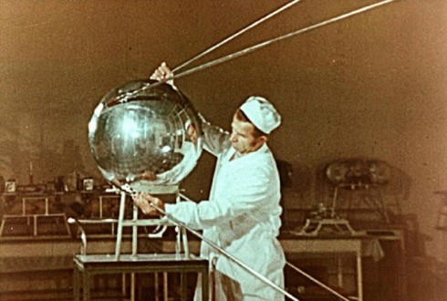
Introduction
Sputnik 1 was the first satellite in space. The Soviet Union launched it in 1957.
NASA launched America’s first man-made satellite the Explorer-1 in 1958.
The first crude image taken by the satellite Explorer 6 shows a sunlit area of the Central Pacific Ocean and its cloud cover. The photo was taken when the satellite was about 17,000 mi above the surface of the earth on August 14, 1959.

Slide 3
Introduction
Usage of satellites: communication, navigation, studying planets, etc.
Starlink constellation will include nearly 12,000 satellites once they’ve all launched.
All space junk is the result of us launching objects from Earth, and it remains in orbit until it re-enters the atmosphere.
34,000 pieces of space junk larger than 10 centimeters
In this project, we are visualizing active satellites

Slide 4
Dataset
Dataset is created by the Union of Concerned Scientists (UCS)
Dataset contains 2666 active satellites
28 types of data for each satellite
Contains technical information: mass, power, launch date, expected lifetime
Contains orbit information: apogee, perigee, inclination, and period
Contains information on what the satellite is used for
Contains information on who owns, operates, and built the satellite.
Dataset link: https://www.ucsusa.org/resources/satellite-database
Notes:
The point at which the satellite is closest to the earth in an elliptical orbit is called the perigee.
The point at which the satellite is furthest from the earth in an elliptical orbit is called the apogee.

Slide 5
Outline of our Story
Visualization 1
A color map showing number of satellites in all the countries
Visualization 2
Multi-series line chart showing trends in satellites application areas
Visualization 3
A 3-D visualization showing different types of satellite orbits around the Earth
Visualization 4
A 3-D visualization showing all the satellites revolving around the Earth in their designated orbit

Slide 6
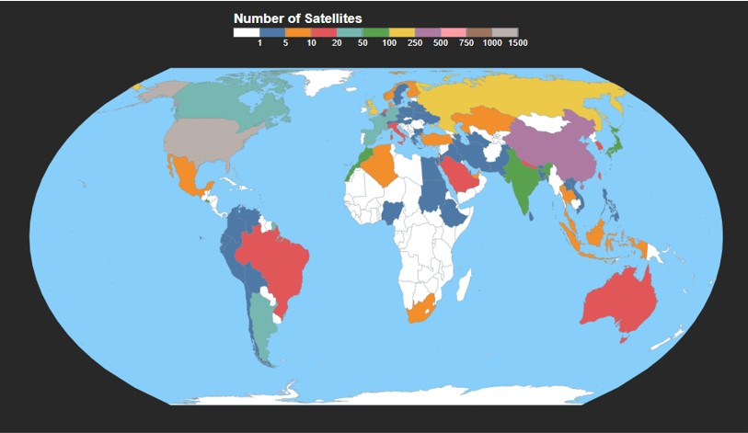
Who’s launching satellites?
The map shows the number of satellites launched by each country
Top three countries in number of satellites
USA – 1308
China – 356
Russia - 169

Slide 7
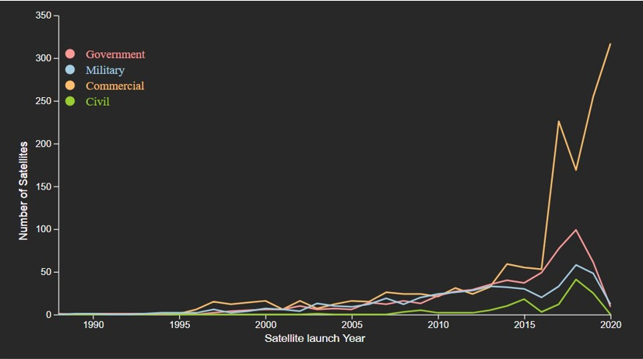
Trends in Satellite Application Areas
The graph represents the number of satellites launched per application area
Recently, the number of commercially launched satellites has seen a greater spike.

Slide 8
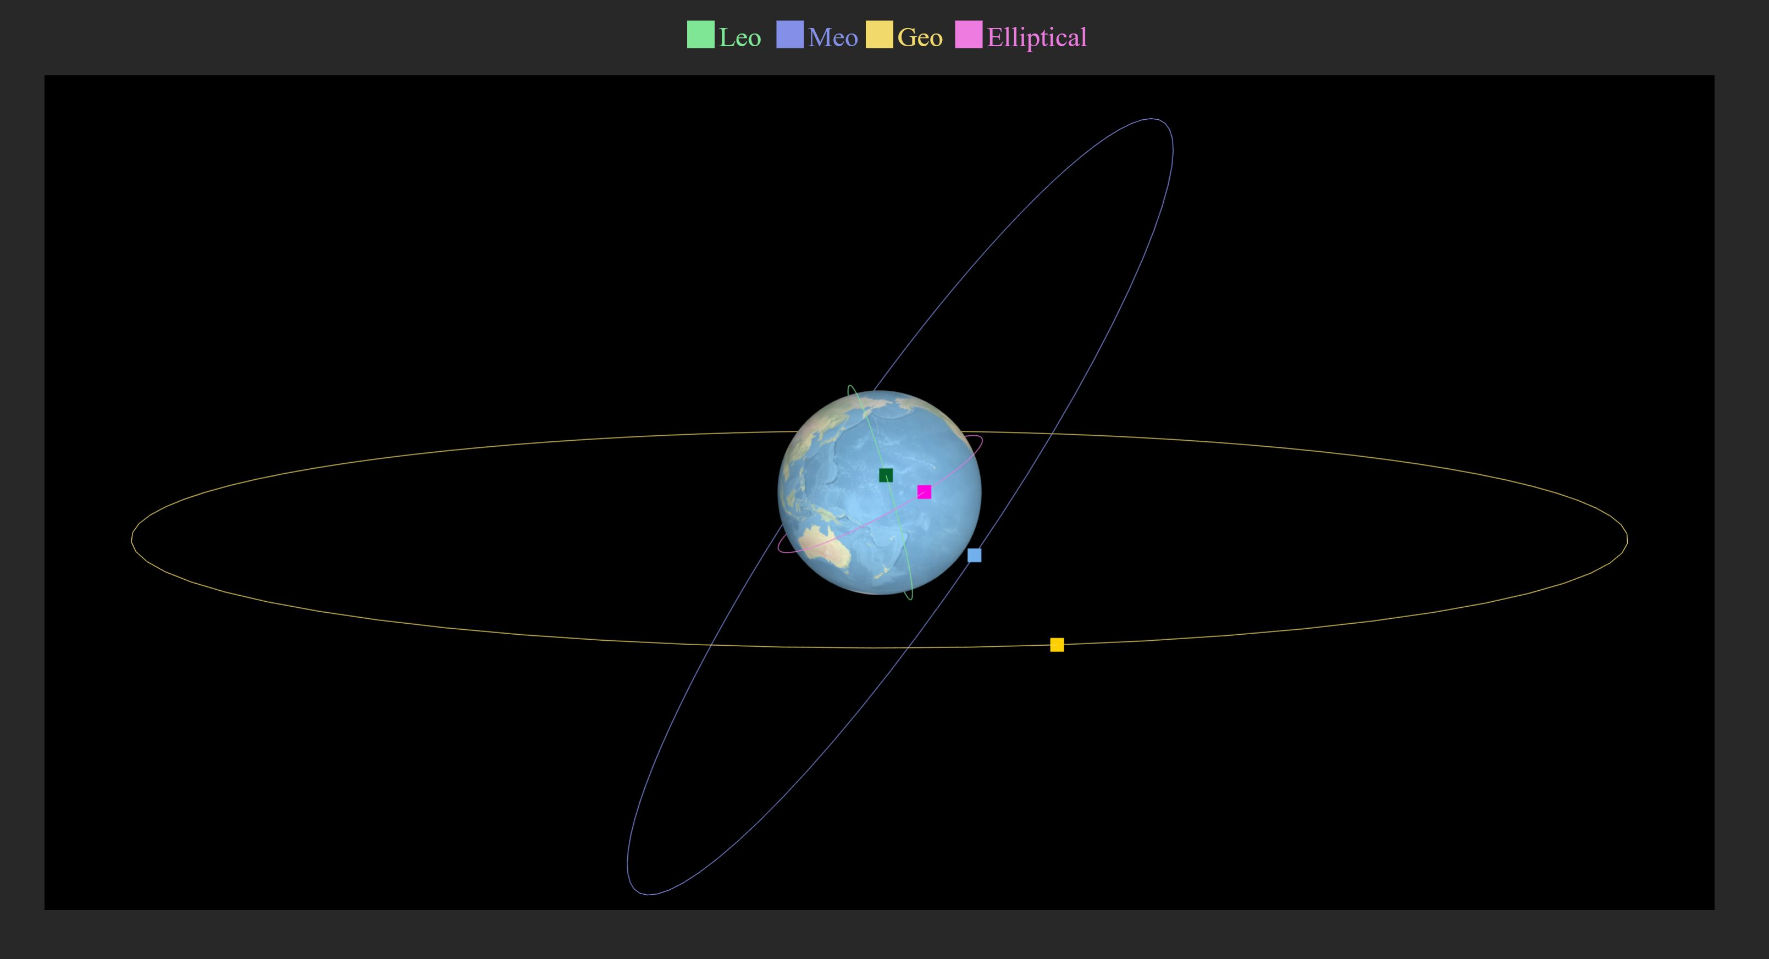
Types of satellite orbits
LEO – Low Earth Orbit
- 100 to 1200 miles above Earth surface
MEO – Medium Earth Orbit
- 8000 miles above Earth surface
GEO – Geostationary Earth Orbit
- 23,000 miles above Earth surface
Elliptical orbit
- Satellites moves in an elliptical orbit

Slide 9
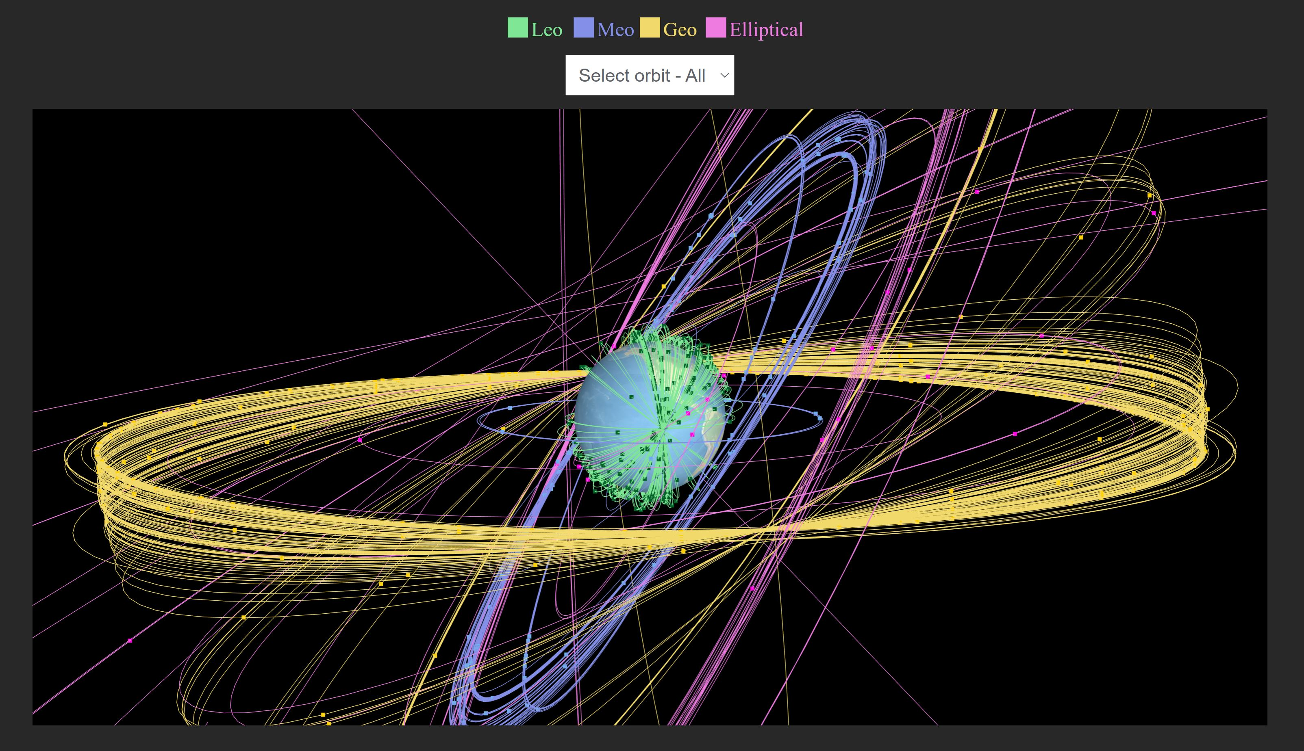
Visualization of all Satellites
This visualization shows how satellites with different orbits revolve around the Earth.
We can select a particular orbit in the visualization

Slide 10
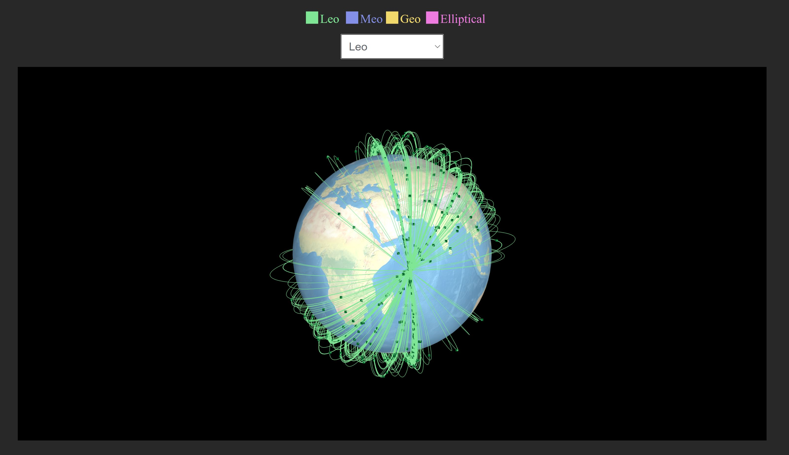
Visualization of Satellites in LEO orbit
One complete orbit in LEO takes about 90 minutes.
Purpose: communications, military reconnaissance, spying and other imaging applications
It is also the orbit used for the International Space Station (ISS)

Slide 11
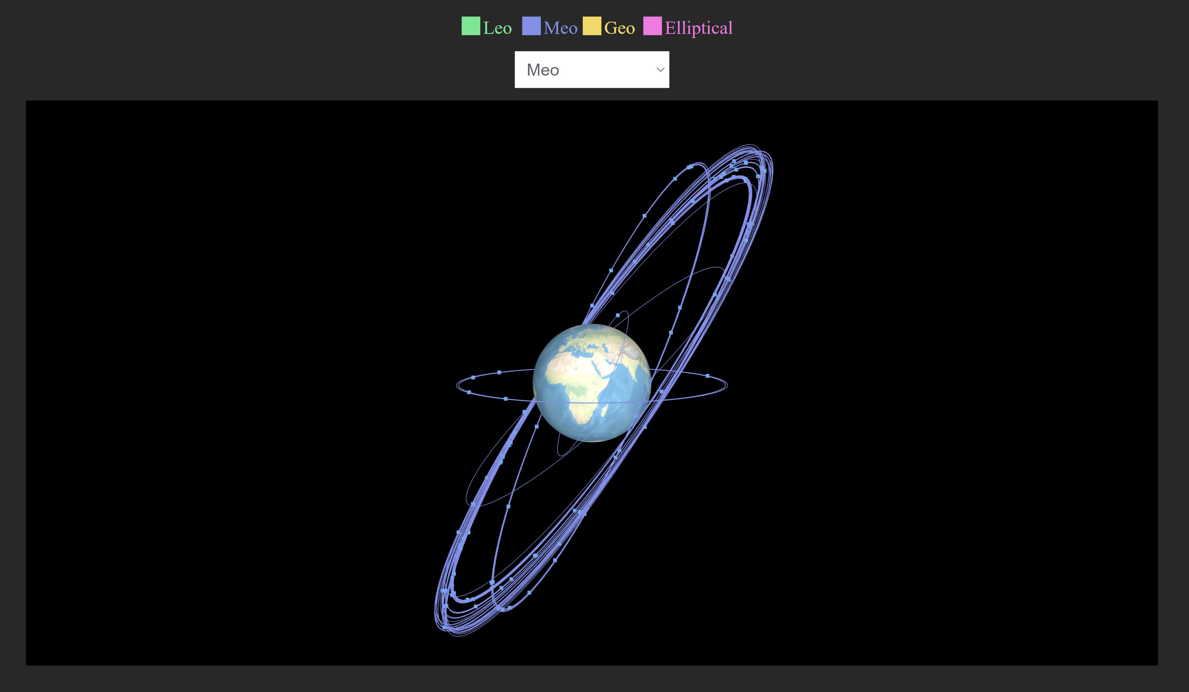
Visualization of Satellites in MEO orbit
One complete orbit in MEO takes about 12 hours
Purpose:
- Navigation
- Communications
- Mobile communications

Slide 12
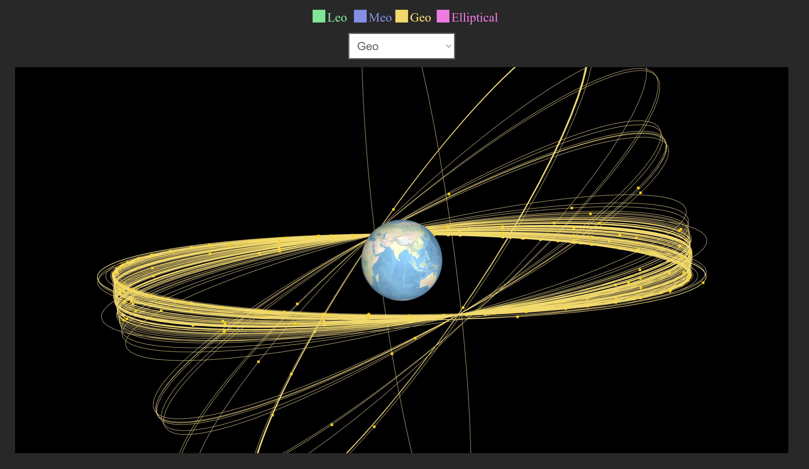
Visualization of Satellites in GEO orbit
It moves in the same direction and at the same rate Earth is spinning.
Purpose: weather forecasting, atmospheric tracking, satellite radio, and television

Slide 13
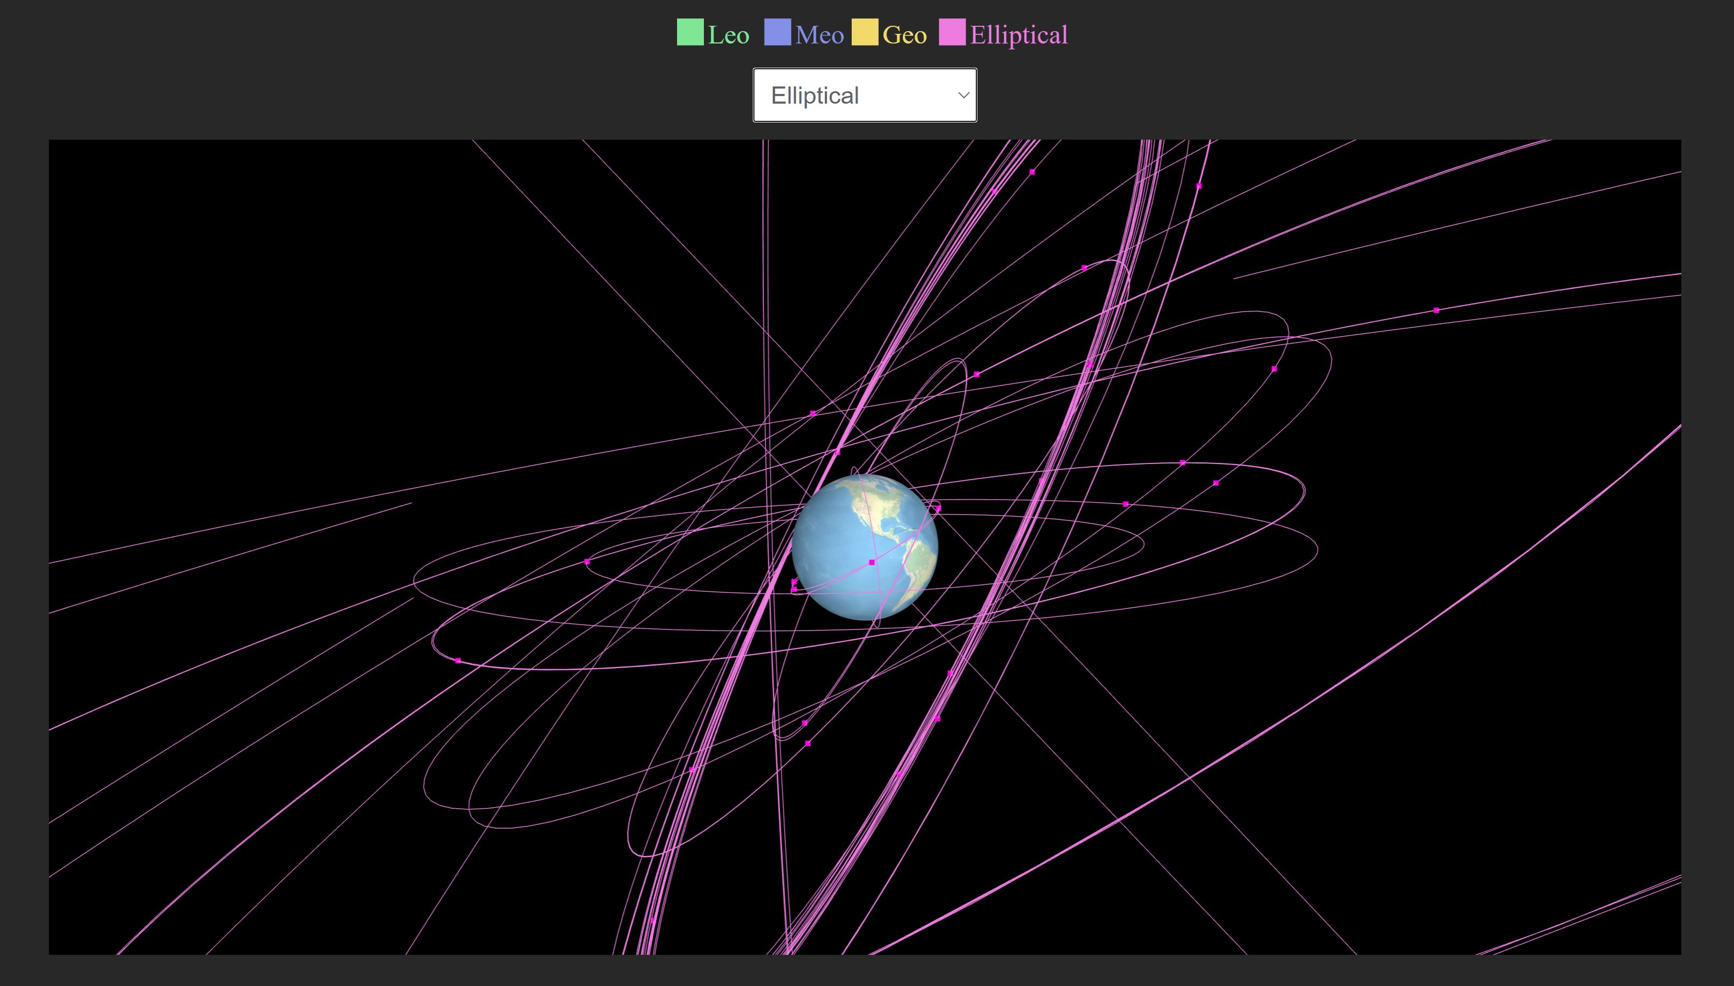
Visualization of Satellites in Elliptical orbit
Satellites rotate in an elliptical orbit at different altitude, so the time taken for one complete rotation varies
Purpose: Elliptical orbits are best suited for communications satellites, as it allows the satellite to be visible to a ground station for a long portion of its orbit and is out of contact for a shorter period of time.

Slide 14
Thank you

